Slide 1



EN-WRMT: WebGIS Portal (WP5 ) and
Web Forum (WP6)
Validation Workshop in Eastern Nile Water Resources Models and Tools
12 - 14th of June 2025
Dr. Binyam Tesfaw Hailu, Miss Beimnet Girma, and Mr. Kedir Hajisheko

Slide 2
Outline
Assess ENTROs data and information platforms, Methodology -WP5
Platform Overview
Front-end structure
EN-Water Resources Models and Tools
    EN-Hydrological and Hydraulic Models
    EN-Water Resource Planning Models
    EN-Sediments and Erosion Transport Models
Users management strategy
Key Functionalities of Web Maps
Authentication and Authorization Protocol
Contact Us section
Web-Forum
Hardware
Links and resources
System infrastructure

Slide 3
Assess ENTROs data and information platforms
No | Existing Portals | Type | Assessment Result
1 | https://ikp.nilebasin.org | Integrated Knowledge Portal | Doesn’t work or an error message appears as “This site can’t be reached”. Migrated to nilebasin.org
2 | https://entrospace.nilebasin.org | ENTROSpace | It works well and the objective is to identify,locate and download research outputs produced by Eastern Nile Technical Regional office(ENTRO). It has functionalities like search a repository, access to login, etc. Will it be fully integrated in nilebasin.org?
3 | https://entro.nilebasin.org/information-hub/entro-knowledge-repository | ENTROSpace | Nothing appears while opening the link in web browsers like Chrome, firefox, opera etc
4 | https://web-ims.web.app/ | WEB-IMS Nile Basin Initiative Web Information Management System | It works very well with a very good performance and better than the other web platforms listed but it has some links that will not go further like a button called “GO TO IKP”.
5 | https://nilebasin.org/entro/index.php/information-hub/technical-documents | ENTRO information hu | The page doesn’t work or an error message appears as “Page Not Found”.
6 | https://nileis.nilebasin.org/ | Nile Information System | This page isn’t working nileis.nilebasin.org is currently unable to handle this request.
7 |  | NB-DAS | No link provided because it is under development stage
https://pagespeed.web.dev/
https://gtmetrix.com/

Slide 4
Methodology– WP5
The actual scope of WP5 is to show the outcomes of the models developed under the other WPs.
A new platform has to be developed, and integrated in the nilebasin.org main website for dissemination purposes. A general section might be accessible to public, while detailed information data and maps are available only to users with access permission.
Other existing platform at ENTRO will be taken into account to understand if data and documents available are worth to be embedded in the new platform.
The main approach is to create a new platform, which is identified as
Eastern Nile Water Resources Models and Tools (EN- WRMT) WEB GIS portal.
EN-WRMT system is a web based open source GIS platform able to host
  Web Maps functionalities and web based time series data visualization,
  Models and Documents
  Other existing tools.

Slide 5
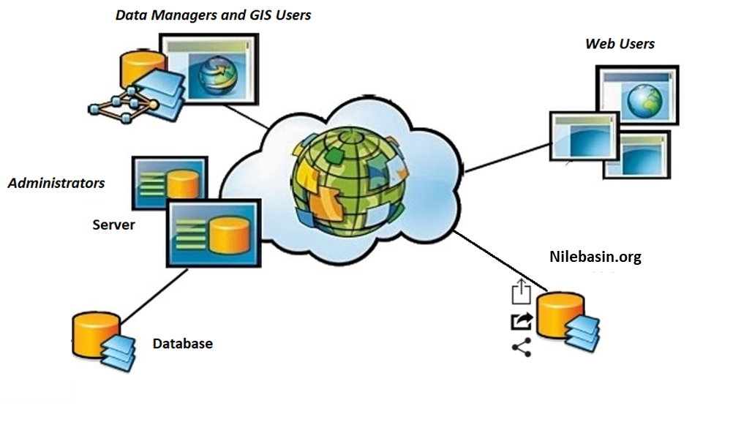
Methodology– WP5
The WebGIS system design have three parts:
Presentation (Web Portal)
Application (Web Server, Application Server, GIS Server)
Database (Relational Database, Spatial Database)

Slide 6


EN- WRMT - Platform Overview
The web platform is designed to provide users with access to geospatial data and models related to EN-Water Resources.
The system is fully linked with a geospatial database (PostGIS) and visualized through MapStore.
Users with different authorization levels can access various functionalities, including
attribute table views,
data filtering, and
dataset downloads in multiple formats (shapefile, CSV, GeoJSON, etc.).
Model downloading that are integrated into the platform is accompanied by a brief description

Slide 7
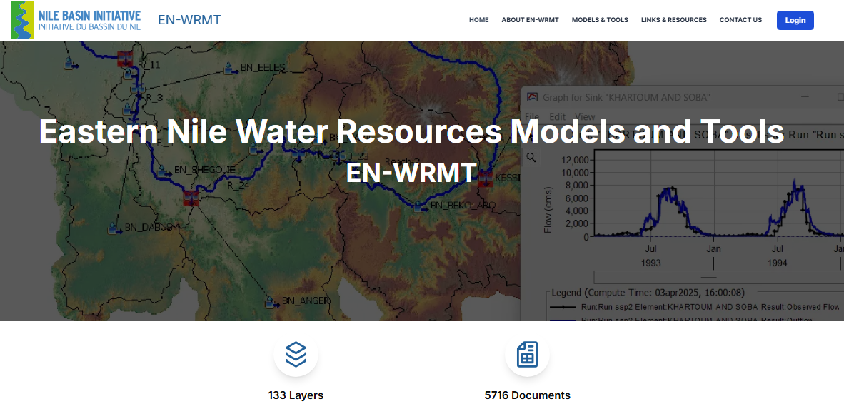
EN- WRMT - Front-end structure

Slide 8
Front-end structure of
EN-Water Resources Models and Tools
EN-Water Resources Models and Tools- It is with username and password
The interface of the system was developed to interact with maps and hydrological data of the project work packages, divided into four main sections:
EN-Hydrological and hydraulics models sub page
  HEC DSSVUE – GetData and Goto Map
  HEC HMS – GetData, Download Models, Dashboards, and Goto Map
  HEC RAS - Goto Map
EN-Water Resources Planning Models sub page
  Maps - HEC-RESSIM Maps both Existing and Future Configuration
EN-Sediments & Erosion Transport Models sub page
  HEC-HMS and SWAT
EN-toolkits Sub page
  EN-Irrigation and Drainage Toolkit
  Watershed Management Toolkit
  EN Power Tools and Guidelines Toolkit
  Information Management System
  CAPMAS Agriculture Database Model
  Eastern Nile Irrigation Toolkit

Slide 9
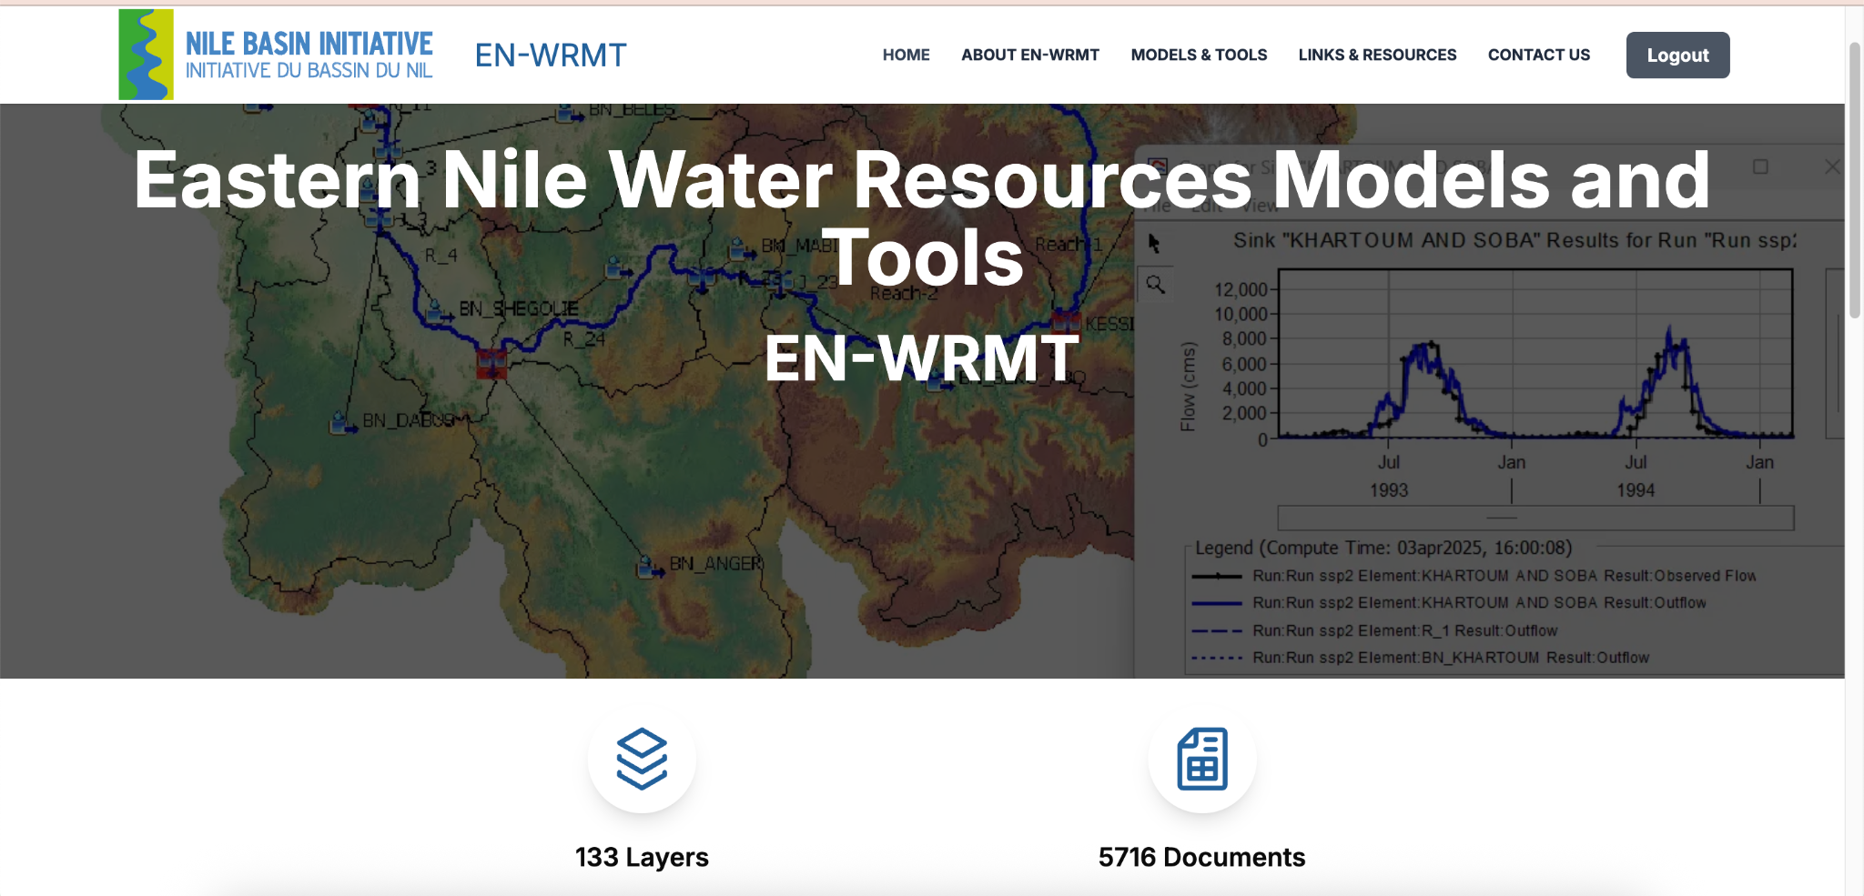

Slide 10
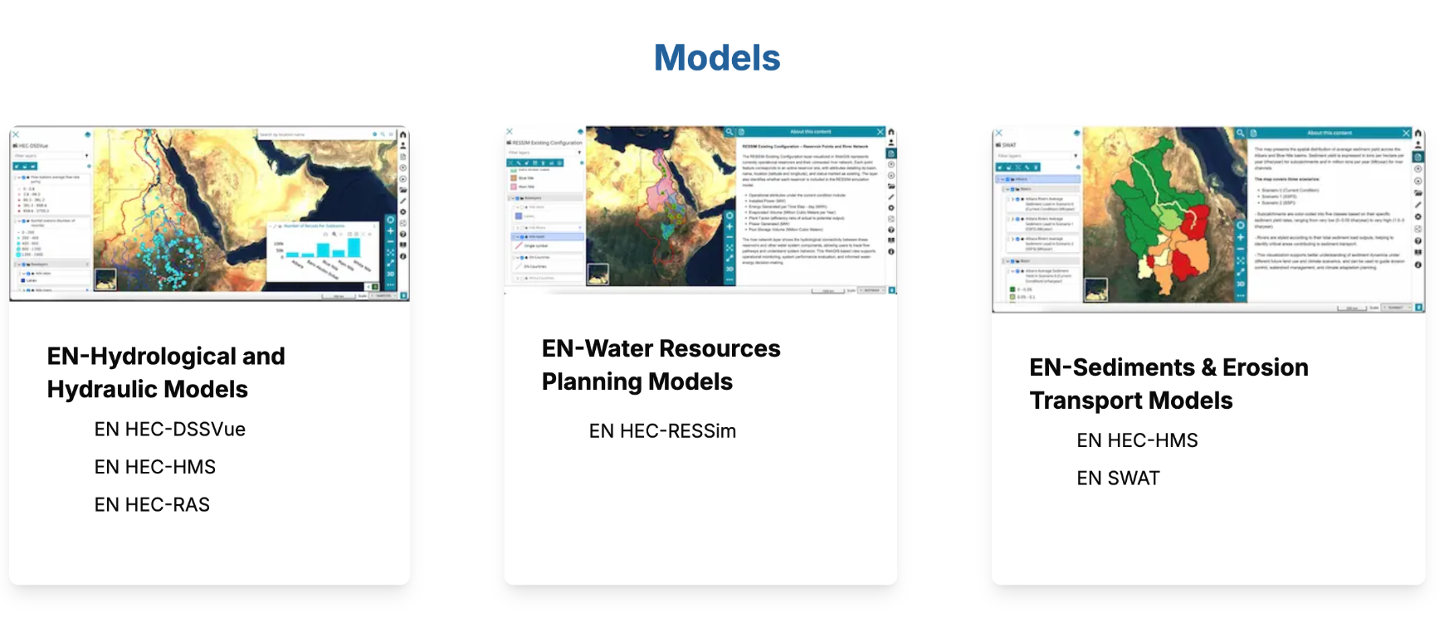

Slide 11
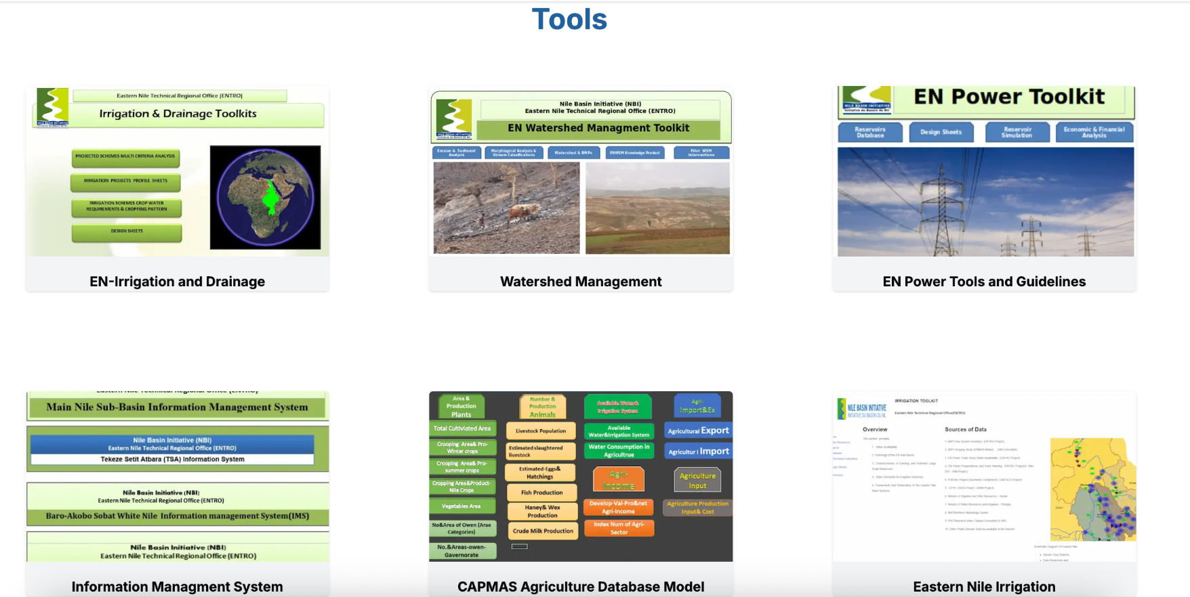

Slide 12
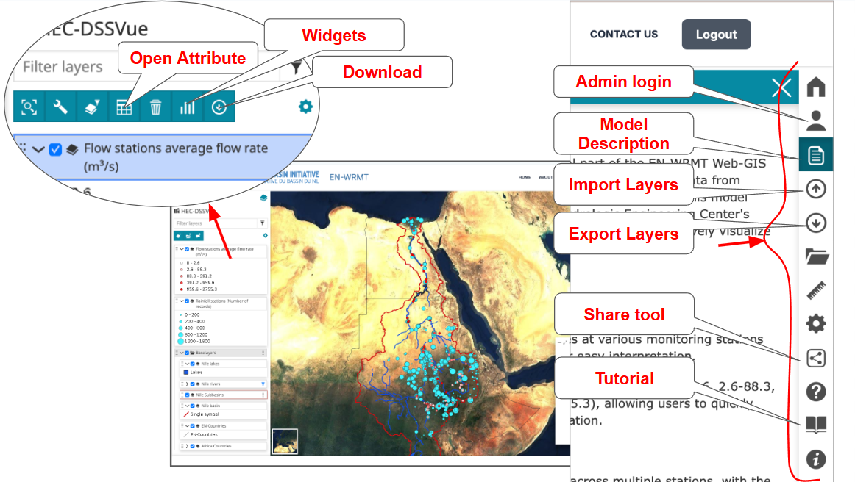
Key Functionalities Of Maps for NBI/ENTRO/Registered Users
Model Description: each model integrated into the platform is accompanied by a brief description for ease of understanding
Access to Attribute Tables: Users can view detailed attribute tables for each layer in the system. And
Data Filtering: Users can filter datasets based on specific attributes for customized analysis.
Download Options: Data is available for download in various formats such as shapefile, CSV, and GeoJSON.
Importing map file or vector data
Exporting maps
Measure area, length and bearing
Share tools
Tutorials on how to use the portal and documentations

Slide 13
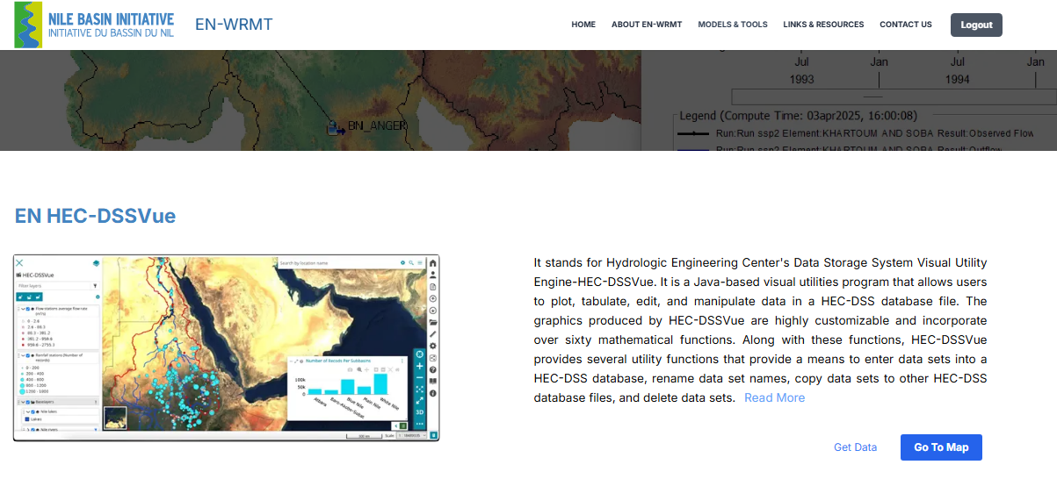
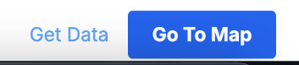
Sub sections: EN-Hydrological and hydraulics models:
HEC-DSSVue
HEC-DSSVue - short description (A link is provided to see the details) https://www.hec.usace.army.mil/software/hec-dssvue/
- Get Data (It takes the users to a window showing the dss and shp files uploaded in the database)
- Go to Maps (It takes the users to the WebGIS Maps with Flow stations average flow rate and Rainfall stations (Number of records)

Slide 14
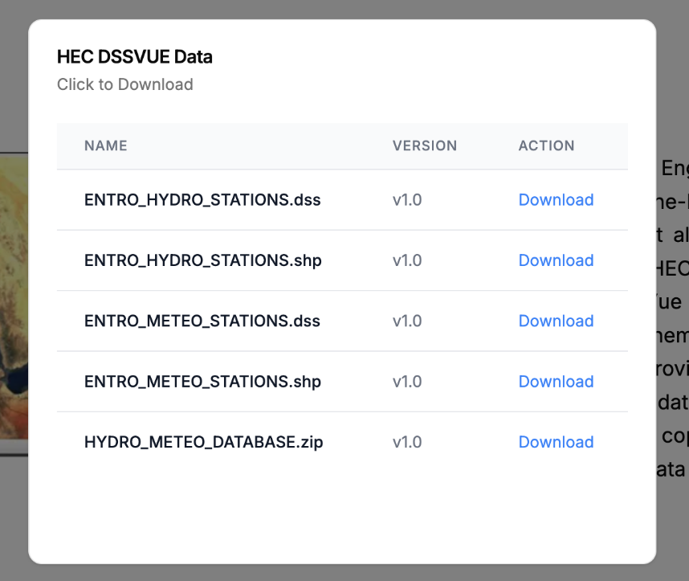
Sub sections: EN-Hydrological and hydraulics models:
HEC-DSSVue
HEC-DSSVue - short description (A link is provided to see the details) https://www.hec.usace.army.mil/software/hec-dssvue/
- Get Data (It takes the users to a window showing the dss and shp files uploaded in the database)
- Go to Maps (It takes the users to the WebGIS Maps with Flow stations average flow rate and Rainfall stations (Number of records)

Slide 15
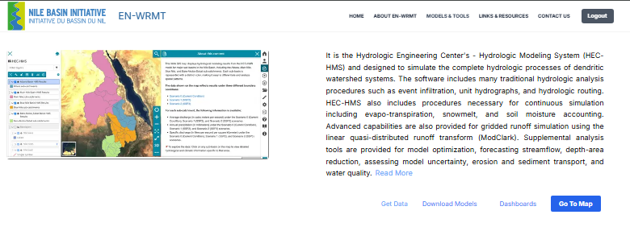
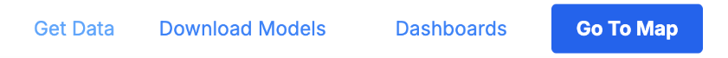
Sub sections: EN-Hydrological and hydraulics models:
HEC-HMS
HEC-HMS - short description (A link is provided to see the details) https://www.hec.usace.army.mil/software/hec-hms/
- Get Data
- Download Models
- Dashboards
- Go To Map
  Atbara Basin HMS Results and Atbara sub-catchments
  Main Nile Basin HMS Results and Main Nile sub-catchments
  Blue Nile Basin HMS Results and Blue Nile sub-catchments
  Baro-Akobo_Sobat Basin HMS Results and Baro-Akobo-Sobat sub-catchments

Slide 16
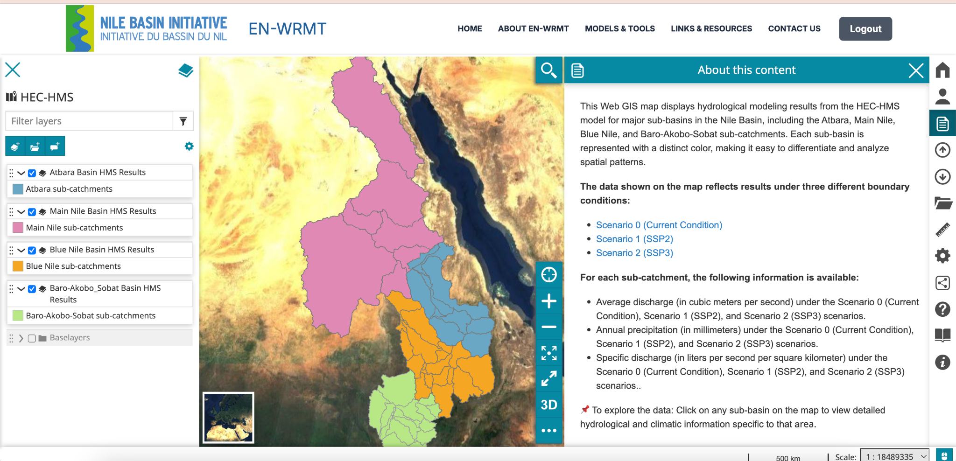
Sub sections: EN-Hydrological and hydraulics models:
HEC-HMS
HEC-HMS - short description (A link is provided to see the details) https://www.hec.usace.army.mil/software/hec-hms/
- Get Data
- Download Models
- Dashboards
- Go To Map
  Atbara Basin HMS Results and Atbara sub-catchments
  Main Nile Basin HMS Results and Main Nile sub-catchments
  Blue Nile Basin HMS Results and Blue Nile sub-catchments
  Baro-Akobo_Sobat Basin HMS Results and Baro-Akobo-Sobat sub-catchments

Slide 17
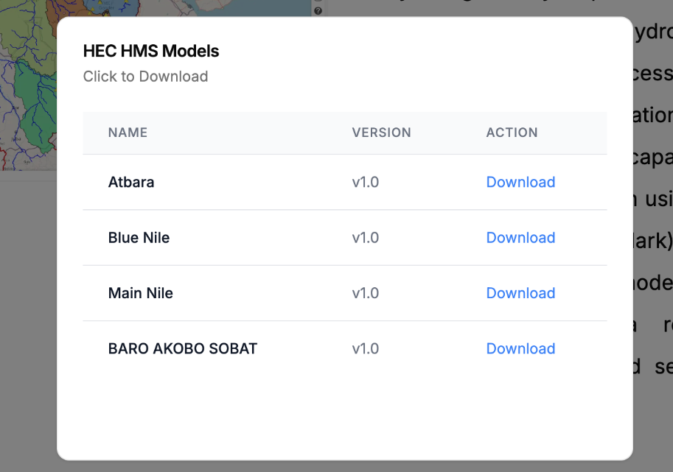
Sub sections: EN-Hydrological and hydraulics models:
HEC-HMS Models
HEC-HMS - short description (A link is provided to see the details) https://www.hec.usace.army.mil/software/hec-hms/
- Get Data
- Download Models
- Dashboards
- Go To Map
  Atbara Basin HMS Results and Atbara sub-catchments
  Main Nile Basin HMS Results and Main Nile sub-catchments
  Blue Nile Basin HMS Results and Blue Nile sub-catchments
  Baro-Akobo_Sobat Basin HMS Results and Baro-Akobo-Sobat sub-catchments

Slide 18
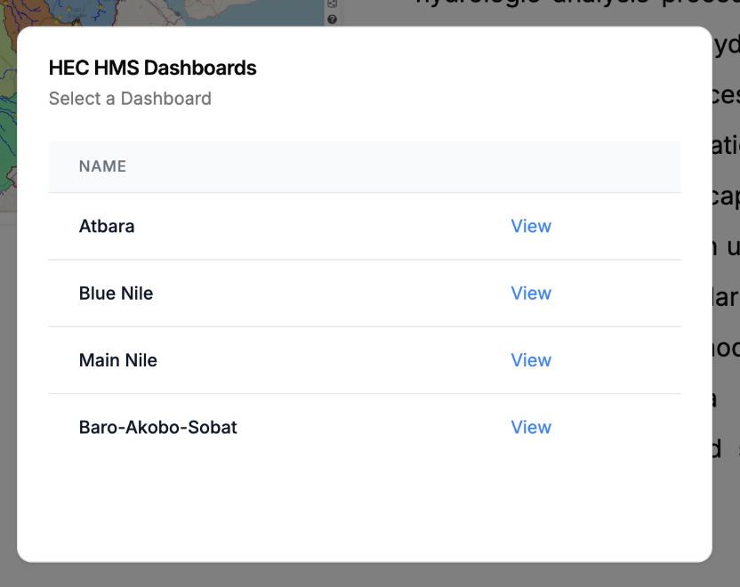
Sub sections: EN-Hydrological and hydraulics models:
HEC-HMS Dashboards
HEC-HMS - short description (A link is provided to see the details) https://www.hec.usace.army.mil/software/hec-hms/
- Get Data
- Download Models
- Dashboards
- Go To Map
  Atbara Basin HMS Results and Atbara sub-catchments
  Main Nile Basin HMS Results and Main Nile sub-catchments
  Blue Nile Basin HMS Results and Blue Nile sub-catchments
  Baro-Akobo_Sobat Basin HMS Results and Baro-Akobo-Sobat sub-catchments

Slide 19
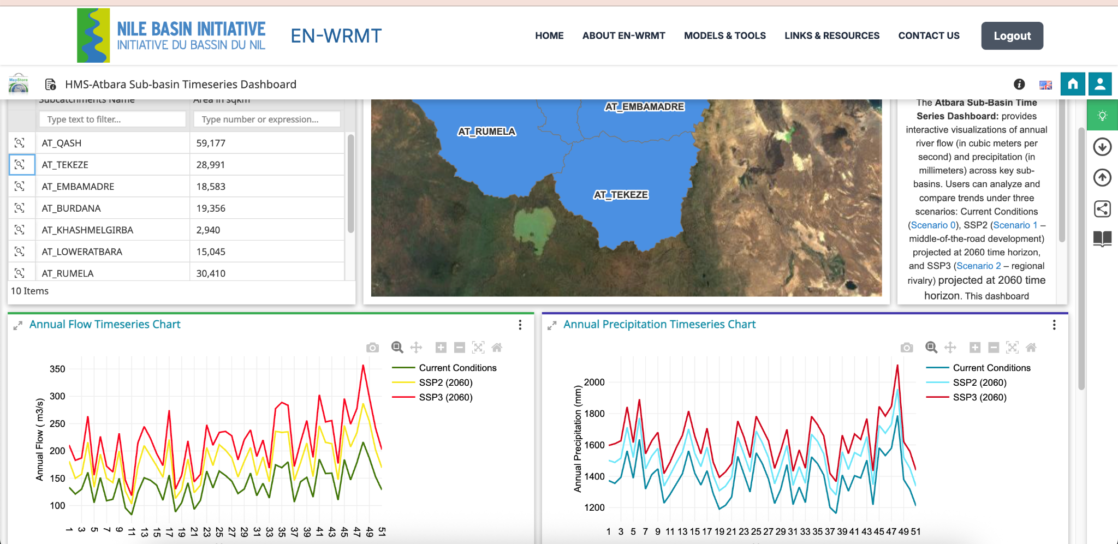
Sub sections: EN-Hydrological and hydraulics models:
HEC-HMS Dashboards

Slide 20
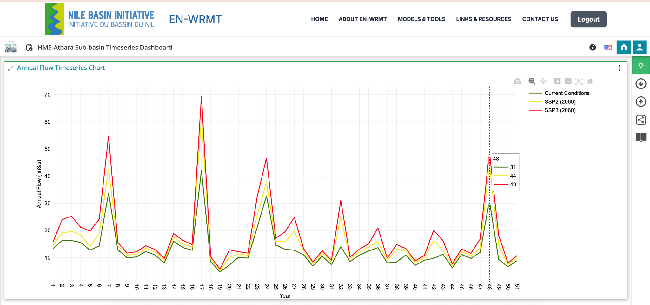
Sub sections: EN-Hydrological and hydraulics models:
HEC-HMS Dashboards

Slide 21
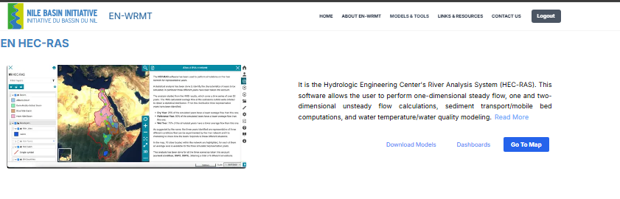

Sub sections: EN-Hydrological and hydraulics models:
HEC-RAS
HEC-RAS - short description (A link is provided to see the details)
- Go To Map (It takes the users to the WebGIS Maps of
Average water level Average level [m a.s.l.] for a dry year,
Average level [m a.s.l.] for a reference year, and
Average level [m a.s.l.] for a wet year
  Average Level Scenario 0 (Current Condition)
  Average Level Scenario 1 (SSP2)
  Average Level Scenario 2 (SSP3)
  Rivers- Rivers network

Slide 22
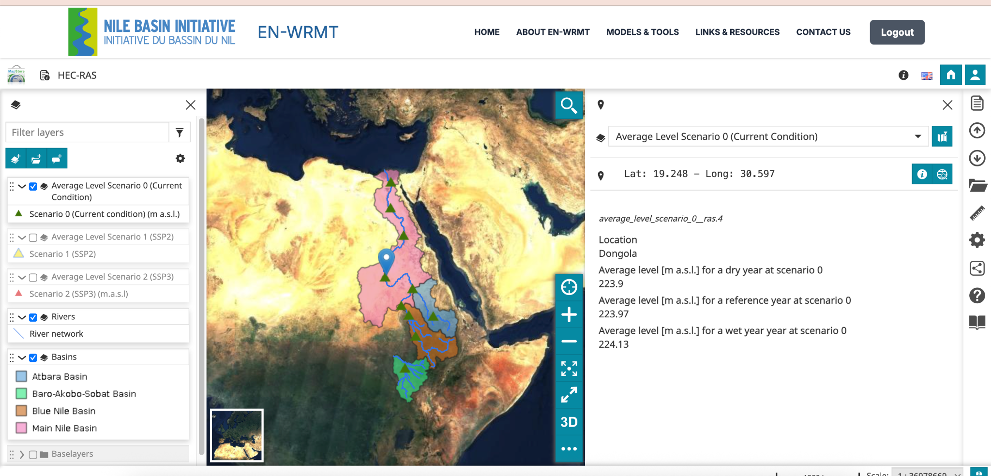
Sub sections: EN-Hydrological and hydraulics models:
HEC-RAS

Slide 23
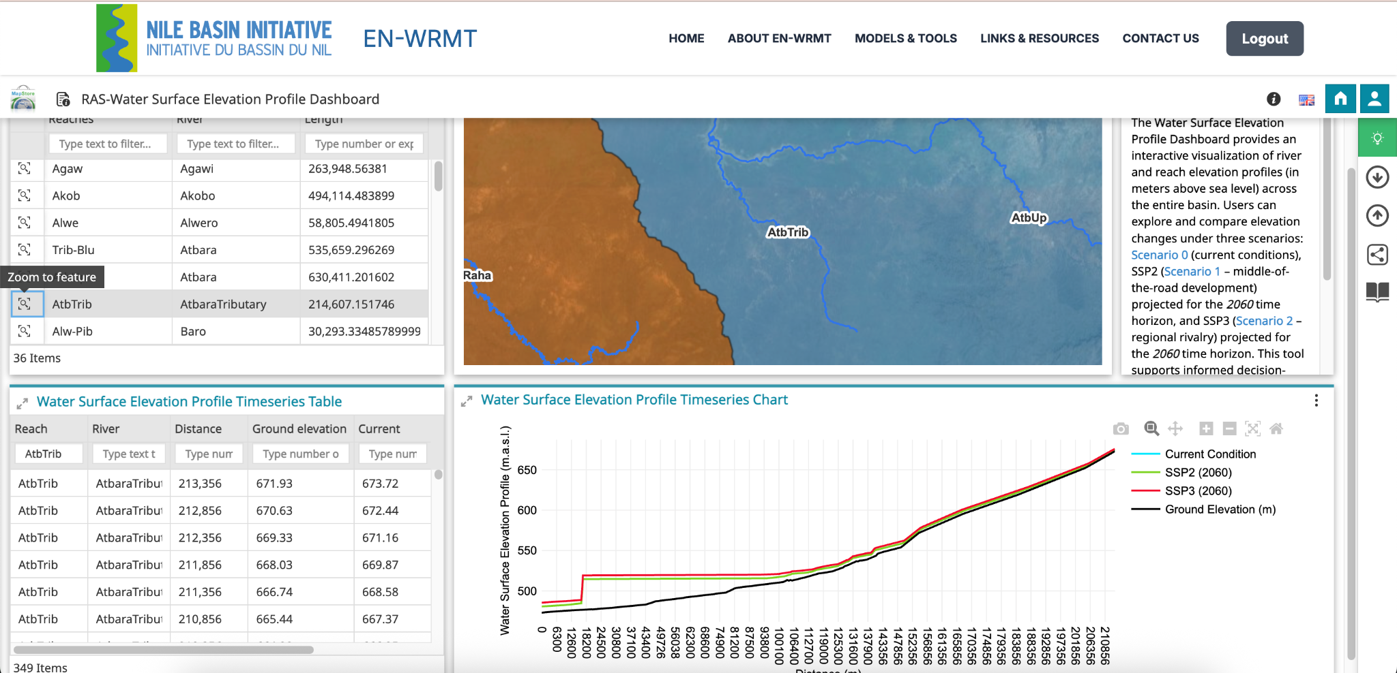
Sub sections: EN-Hydrological and hydraulics models:
HEC-RAS : Water Surface Elevation Profile

Slide 24
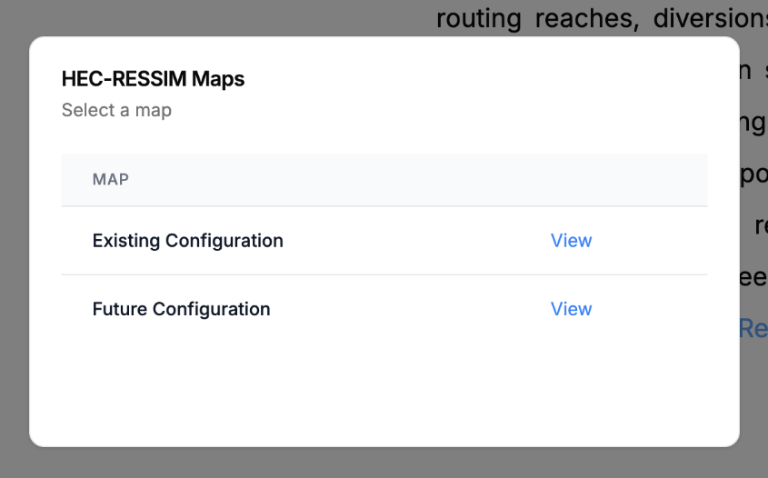
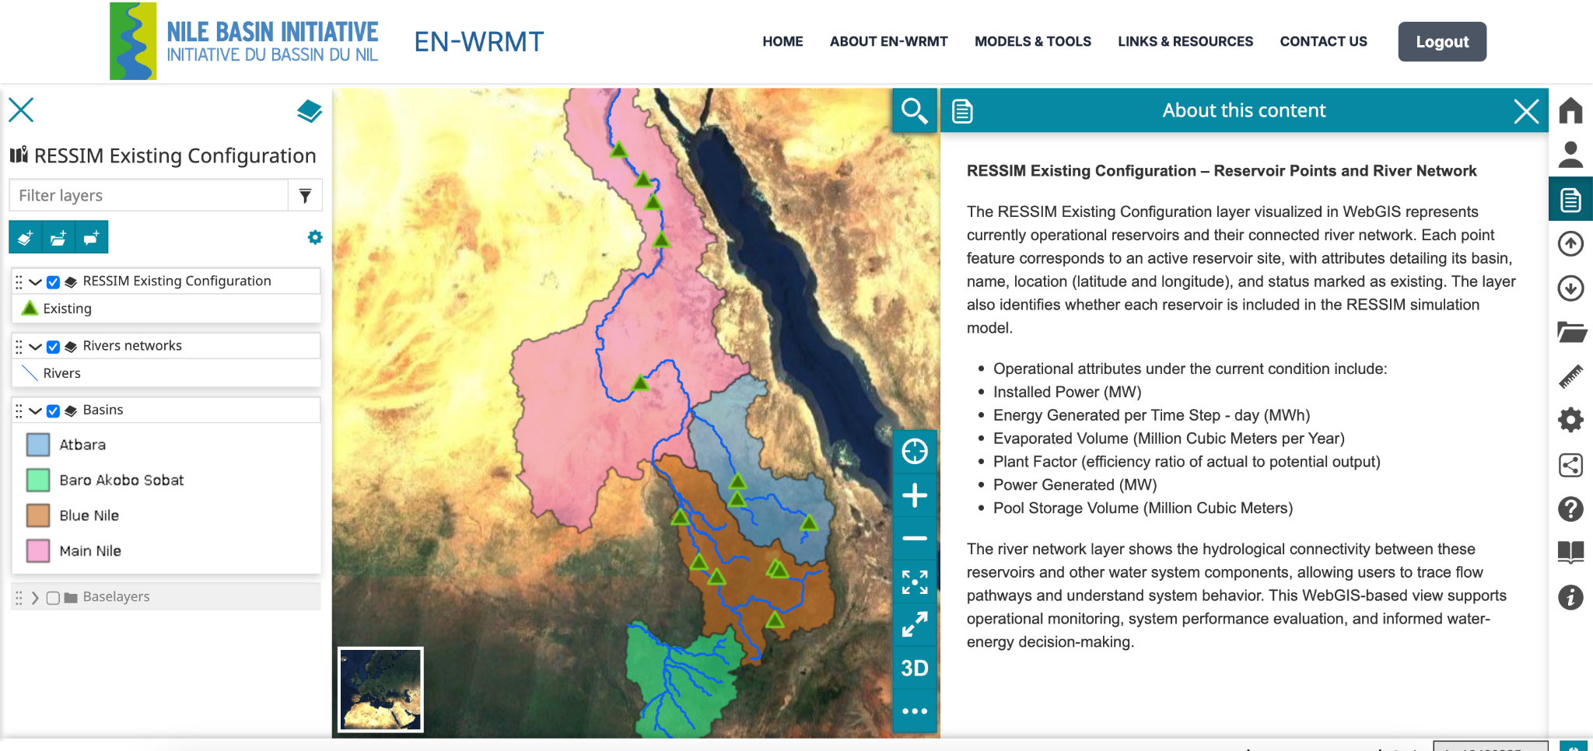
Sub sections: EN-Water Resources Planning Models
HEC-RESSIM
HEC-RESSim- short description (A link is provided to see the details)
- Maps - (It takes the users to the WebGIS Maps of HEC-RESSIM in the Existing Configuration and Future Configuration)
  RESSIM Existing Configuration – Point data of Existing
and Rivers networks
  RESSIM Future Configuration – Point data of Existing, Future and Rivers networks

Slide 25
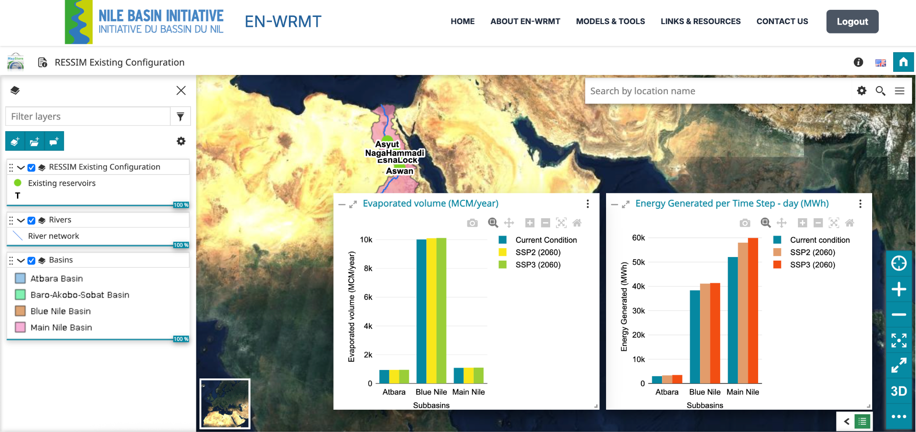
Sub sections: EN-Water Resources Planning Models
HEC-RESSIM

Slide 26
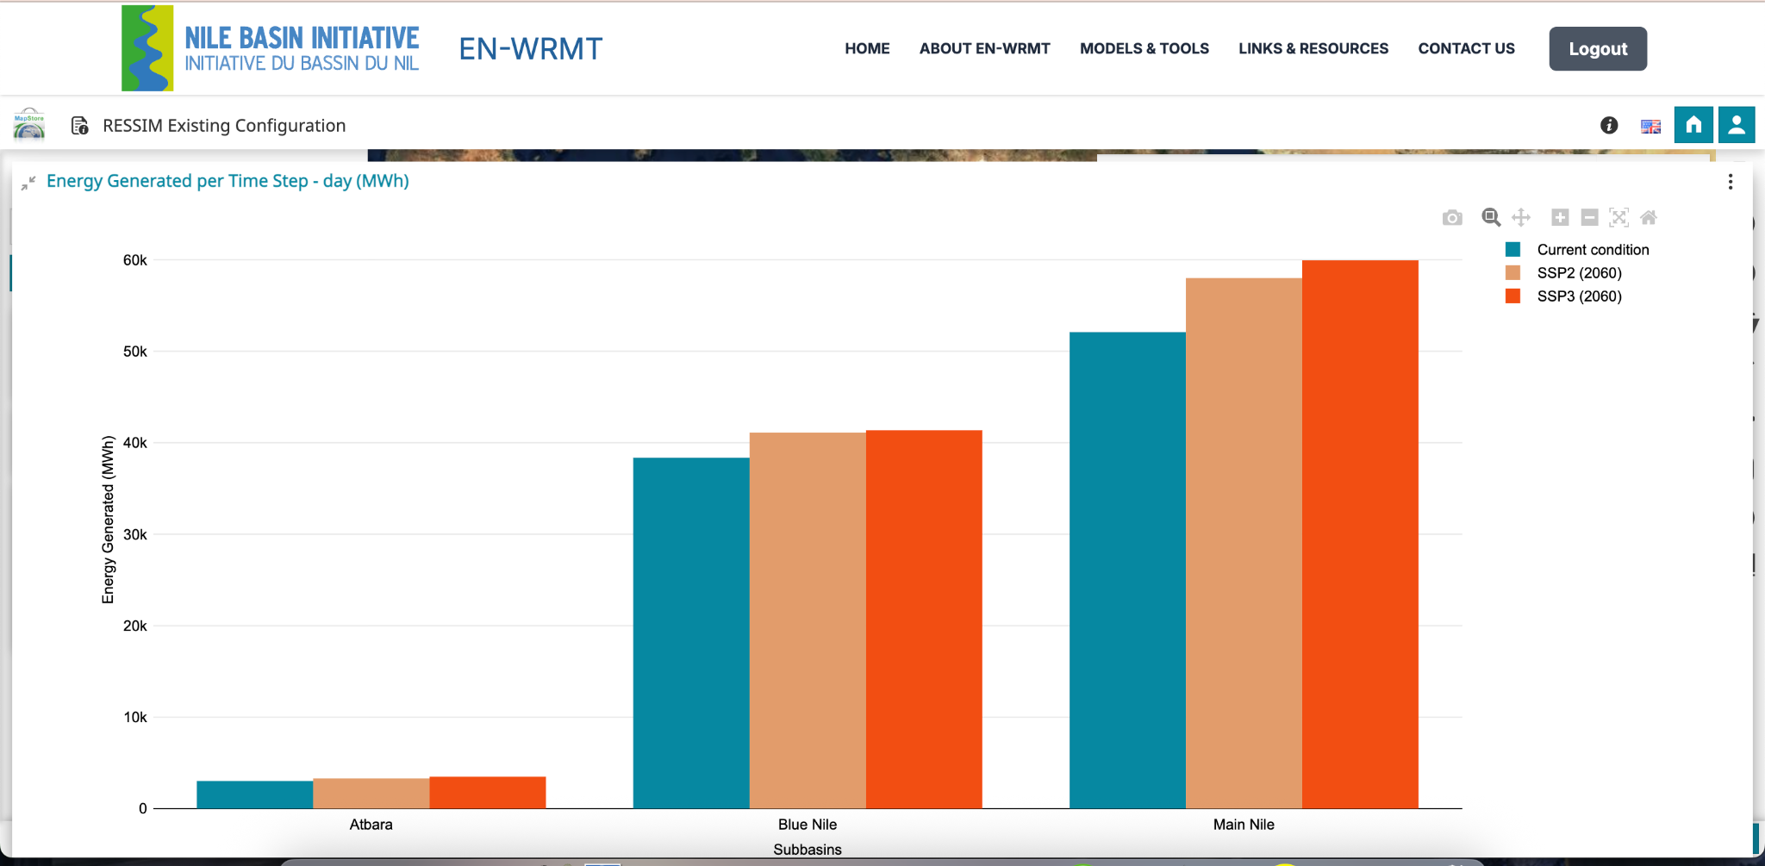
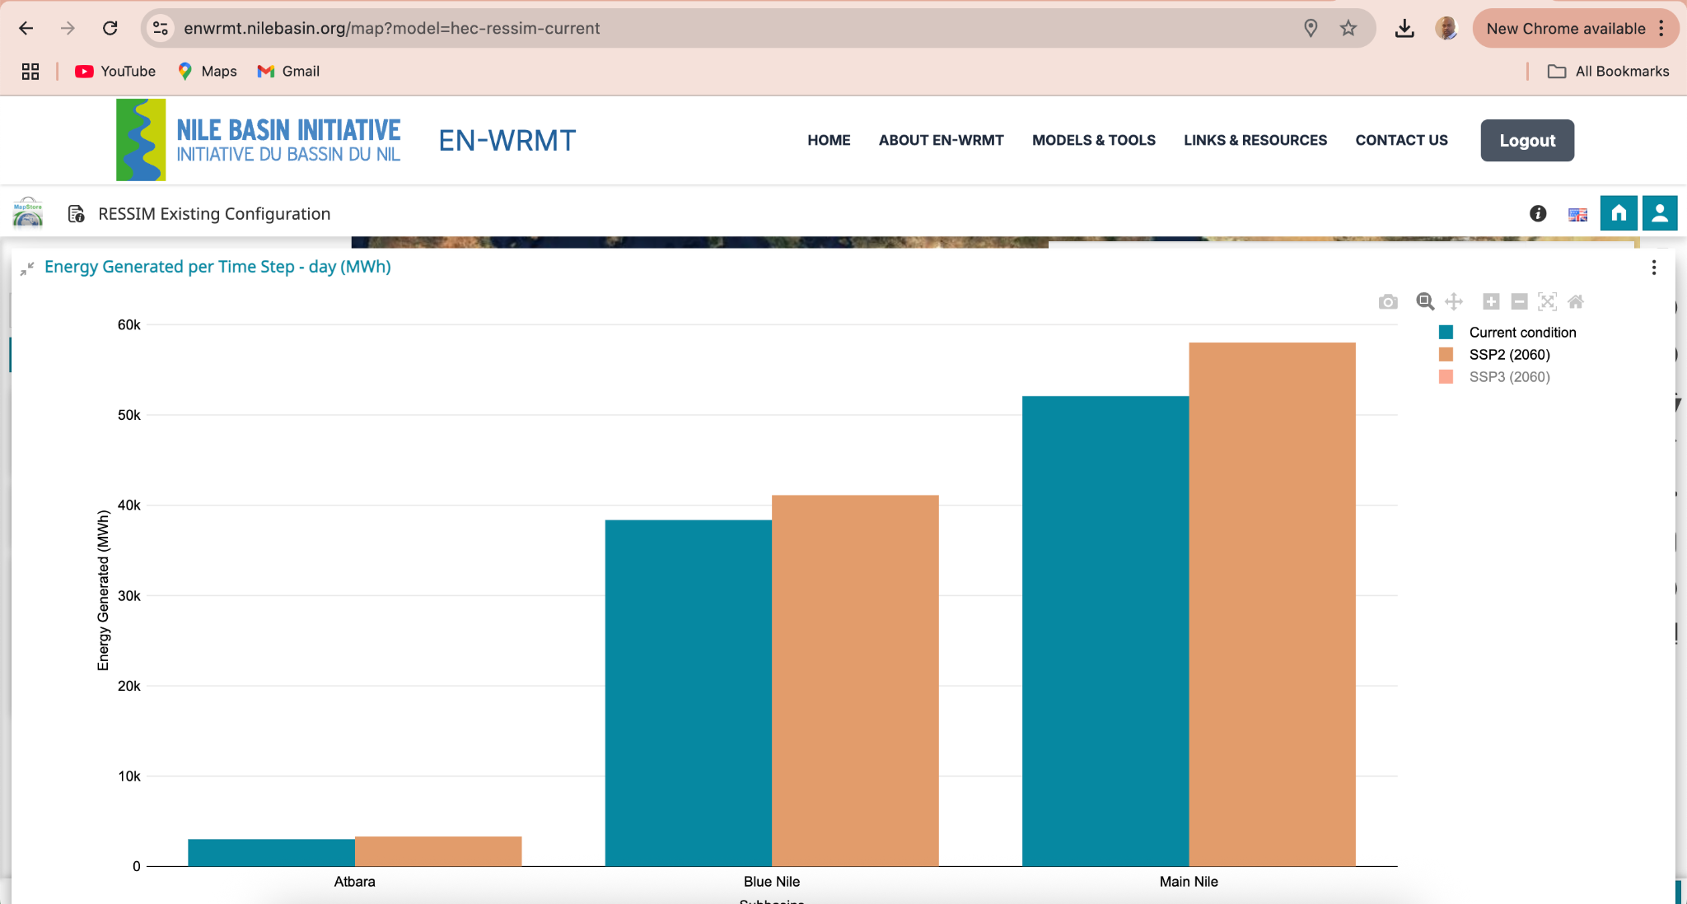
Sub sections: EN-Water Resources Planning Models
HEC-RESSIM

Slide 27
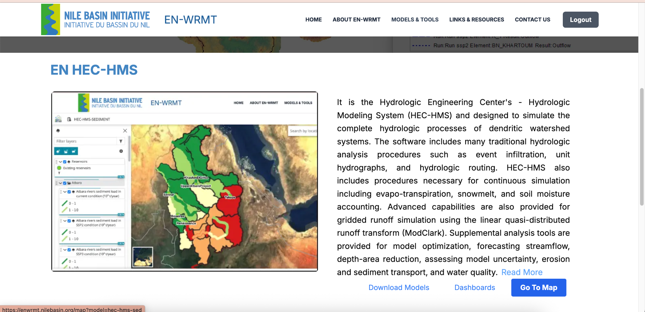
Sub sections: EN-Sediments & Erosion Transport Models: Sediment load, Specific sediment load, and Sediment Concentration
HEC-HMS and SWAT
HEC-HMS
  Go To Map
    Atbara River Sediment, Rivers, and Atbara Basin Sediment
    Blue Nile River Sediment, Rivers, and Blue Nile Basin Sediment
SWAT
  Go To Map
  Scenario 0 (Current Condition), Scenario 1 (SSP2), and Scenario 2 (SSP3)
    Atbara Rivers
    Atbara Basin
    Blue Nile Rivers
    Blue Nile Basin

Slide 28
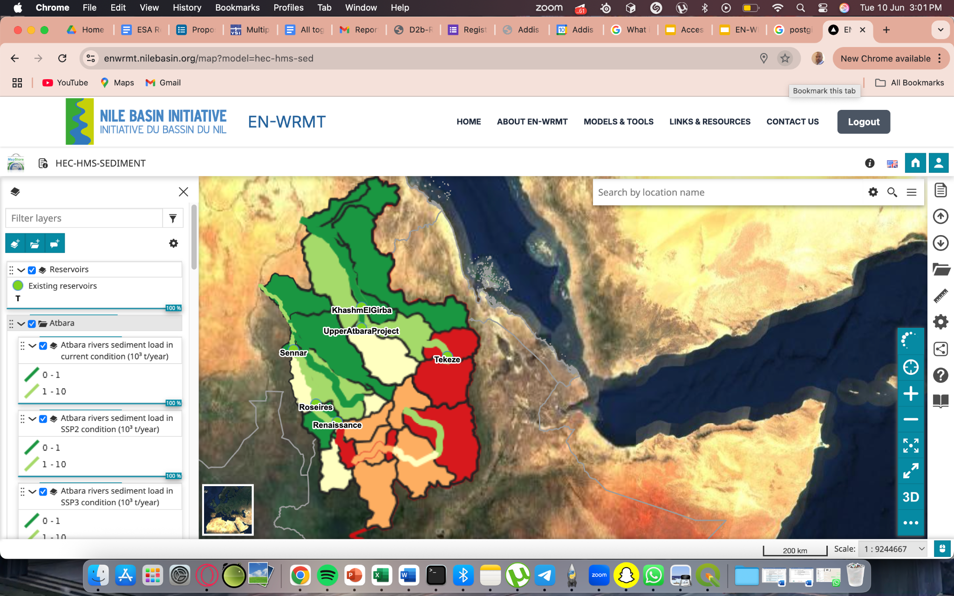
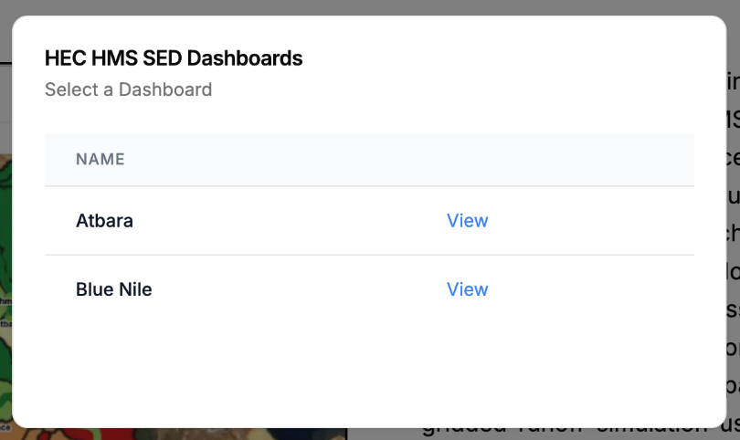
Sub sections: EN-Sediments & Erosion Transport Models: Sediment load, Specific sediment load, and Sediment Concentration
HEC-HMS
HEC-HMS
  Go To Map
    Reservoirs
    Atbara River Sediment, Rivers, and Atbara Basin Sediment
    Blue Nile River Sediment, Rivers, and Blue Nile Basin Sediment

Slide 29
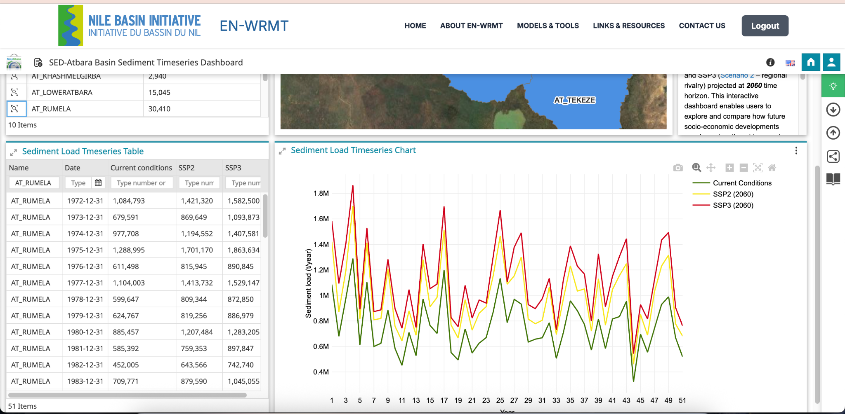
Sub sections: EN-Sediments & Erosion Transport Models: Sediment load, Specific sediment load, and Sediment Concentration
HEC-HMS
HEC-HMS
  Go To Map
    Reservoirs
    Atbara River Sediment, Rivers, and Atbara Basin Sediment
    Blue Nile River Sediment, Rivers, and Blue Nile Basin Sediment

Slide 30
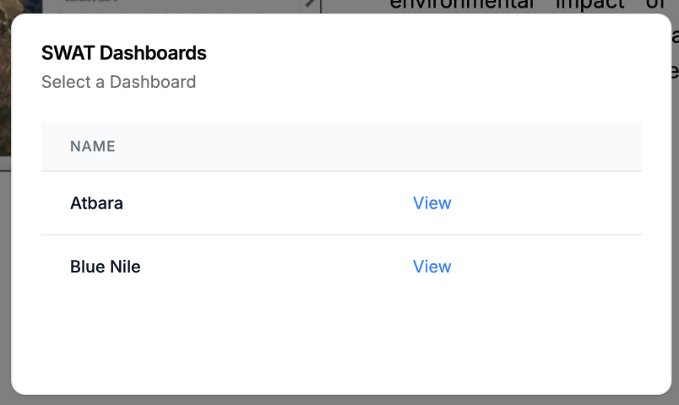
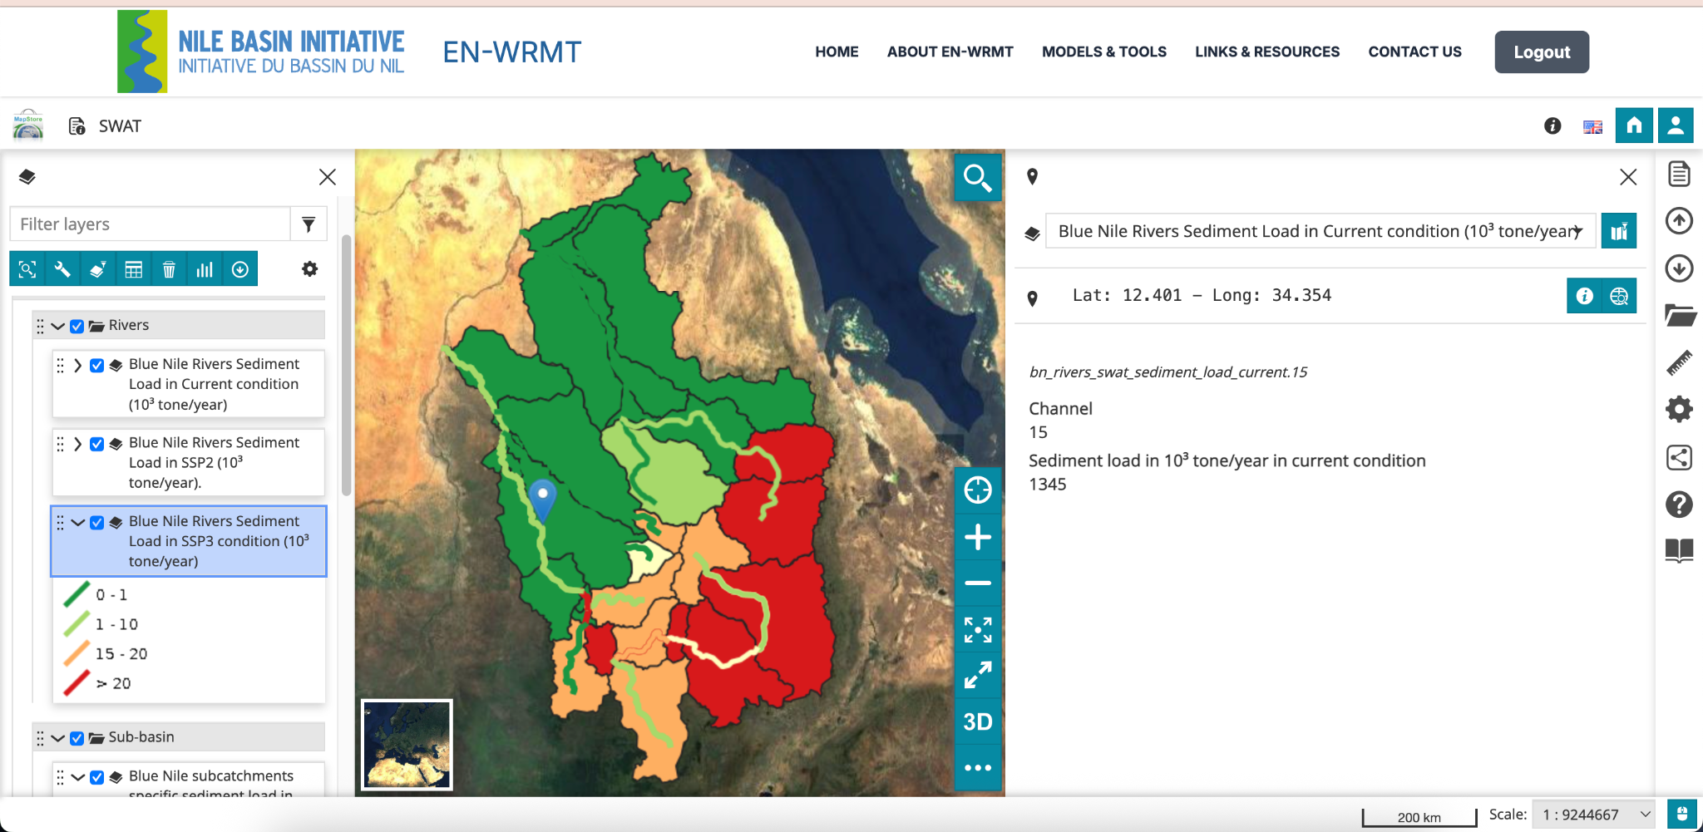
Sub sections: EN-Sediments & Erosion Transport Models: Sediment load, Specific sediment load, and Sediment Concentration
SWAT
SWAT
  Go To Map
  Scenario 0 (Current Condition), Scenario 1 (SSP2), and Scenario 2 (SSP3)
    Atbara Rivers
    Atbara Basin
    Blue Nile Rivers
    Blue Nile Basin

Slide 31
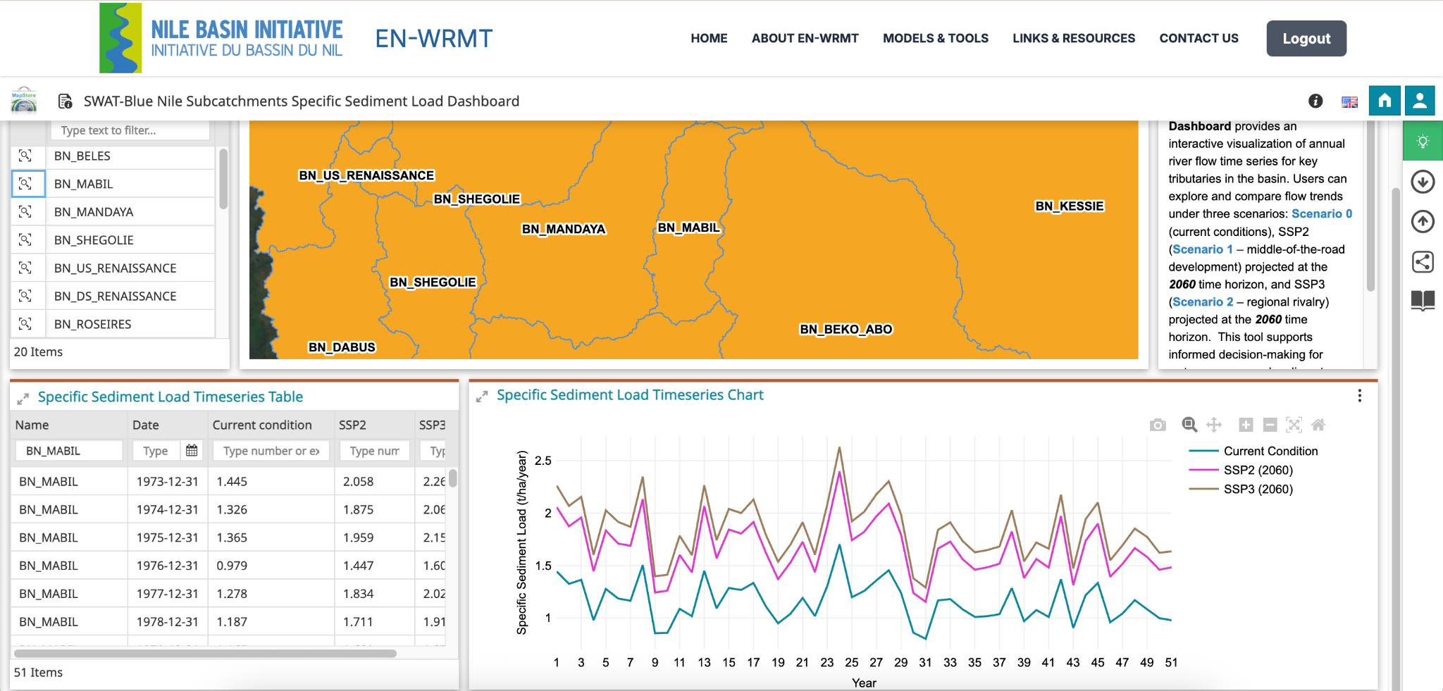
Sub sections: EN-Sediments & Erosion Transport Models: Sediment load, Specific sediment load, and Sediment Concentration
SWAT

Slide 32
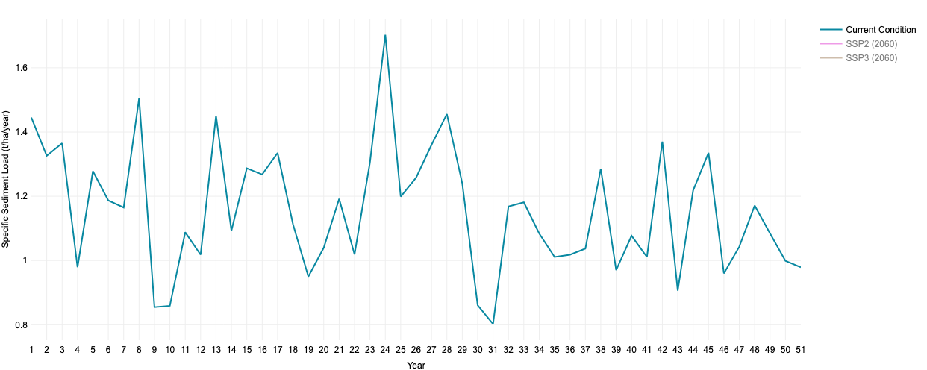
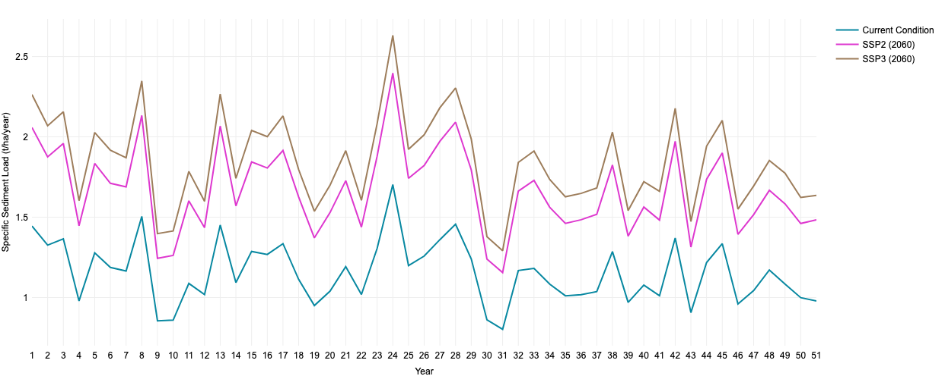
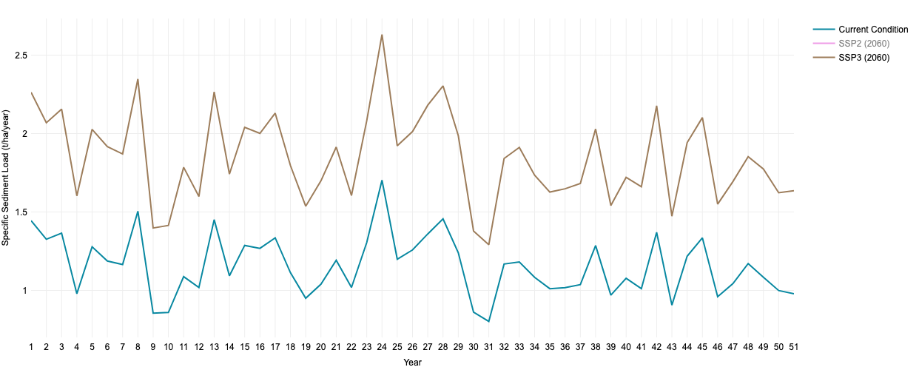
Sub sections: EN-Sediments & Erosion Transport Models: Sediment load, Specific sediment load, and Sediment Concentration
SWAT : Visibility of graphs for each time and/or comparison with time

Slide 33
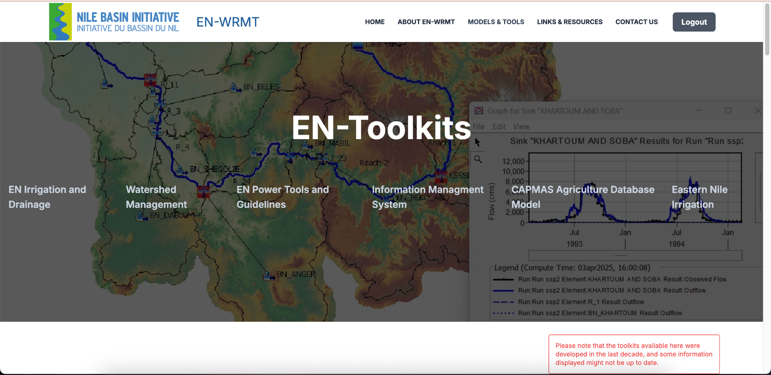
Sub sections: EN-toolkits

Slide 34
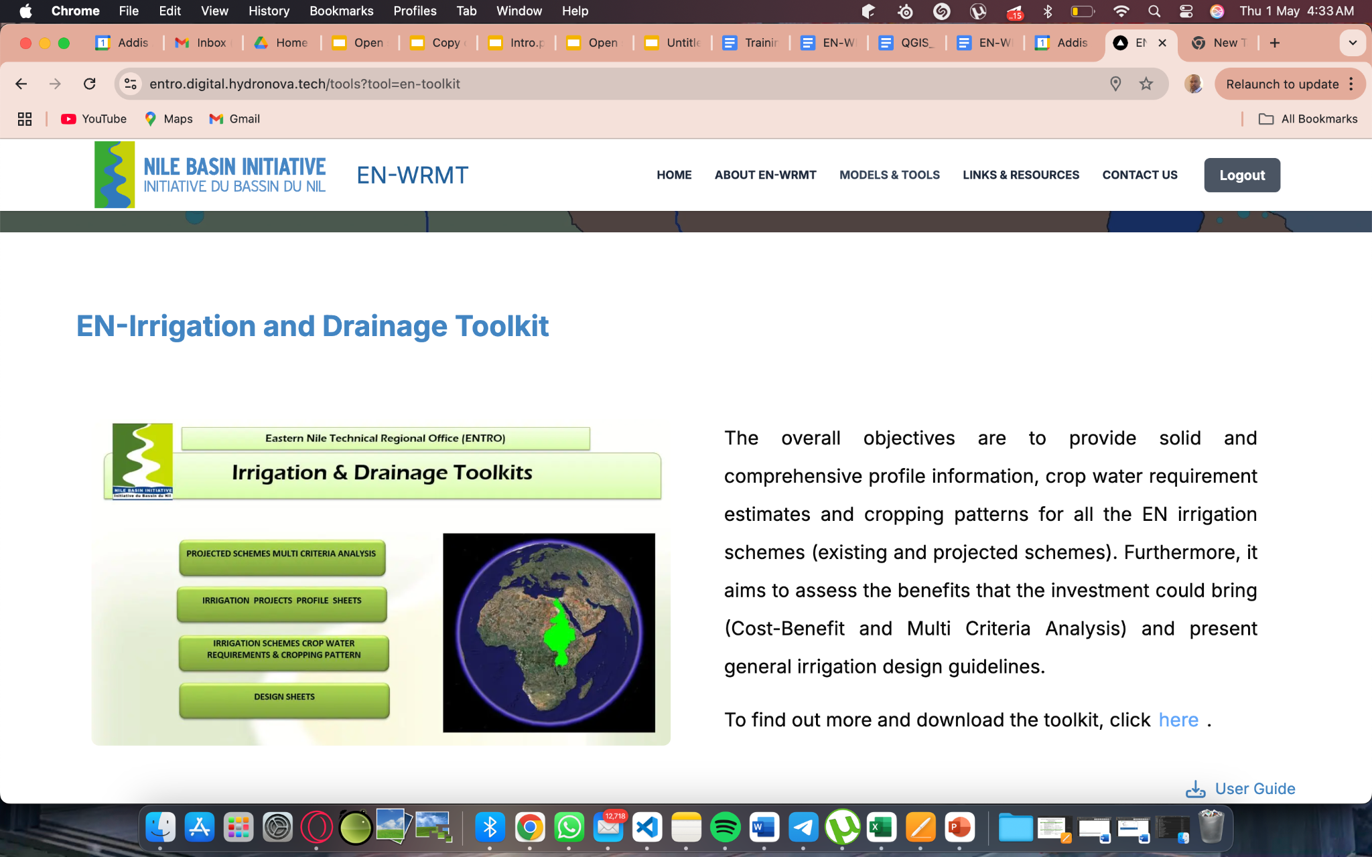
Sub sections: EN-toolkits
EN-Irrigation and Drainage Toolkit
EN-Irrigation and Drainage Toolkit
Watershed Management Toolkit
EN Power Tools and Guidelines Toolkit
Information Management System
CAPMAS Agriculture Database Model
Eastern Nile Irrigation Toolkit

Slide 35
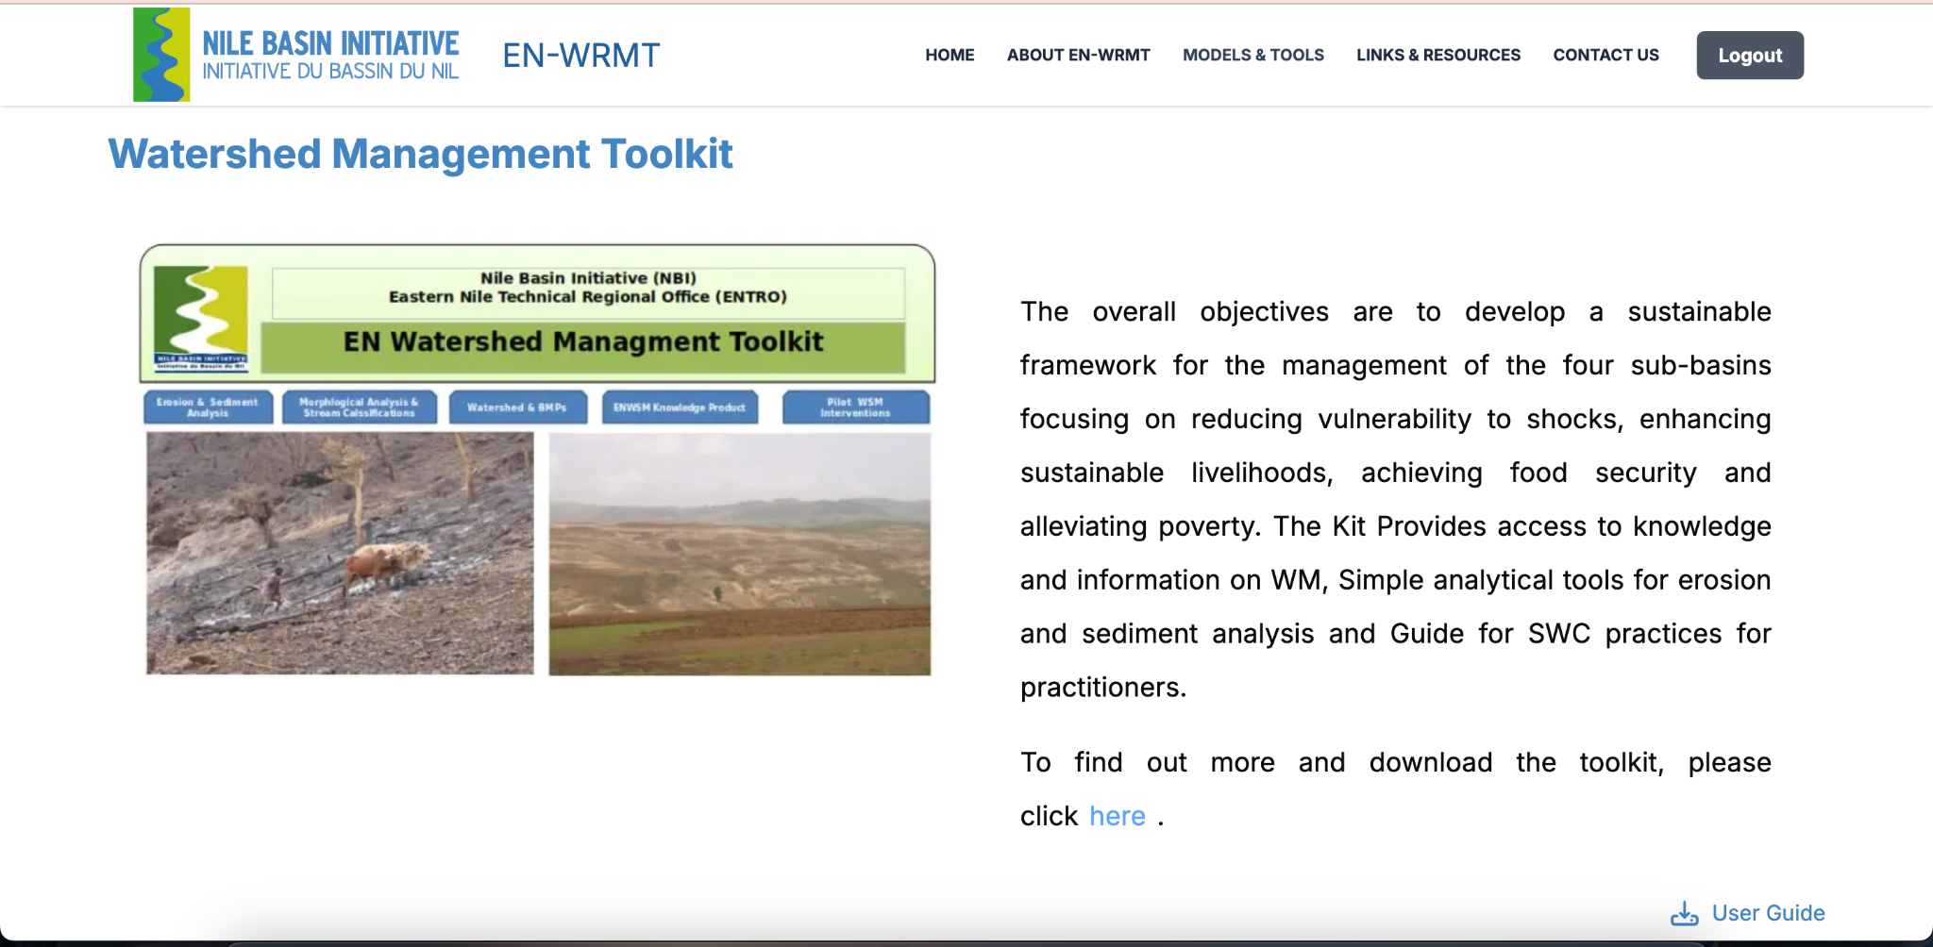
Sub sections: EN-toolkits
Watershed Management Toolkit
EN-Irrigation and Drainage Toolkit
Watershed Management Toolkit
EN Power Tools and Guidelines Toolkit
Information Management System
CAPMAS Agriculture Database Model
Eastern Nile Irrigation Toolkit

Slide 36
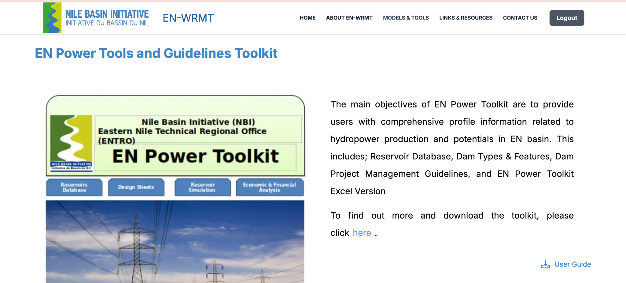
Sub sections: EN-toolkits
EN Power Tools and Guidelines Toolkit
EN-Irrigation and Drainage Toolkit
Watershed Management Toolkit
EN Power Tools and Guidelines Toolkit
Information Management System
CAPMAS Agriculture Database Model
Eastern Nile Irrigation Toolkit

Slide 37
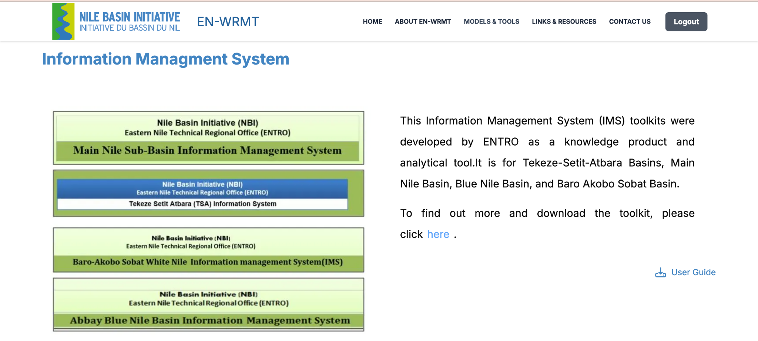
Sub sections: EN-toolkits
Information Management System
EN-Irrigation and Drainage Toolkit
Watershed Management Toolkit
EN Power Tools and Guidelines Toolkit
Information Management System
CAPMAS Agriculture Database Model
Eastern Nile Irrigation Toolkit

Slide 38
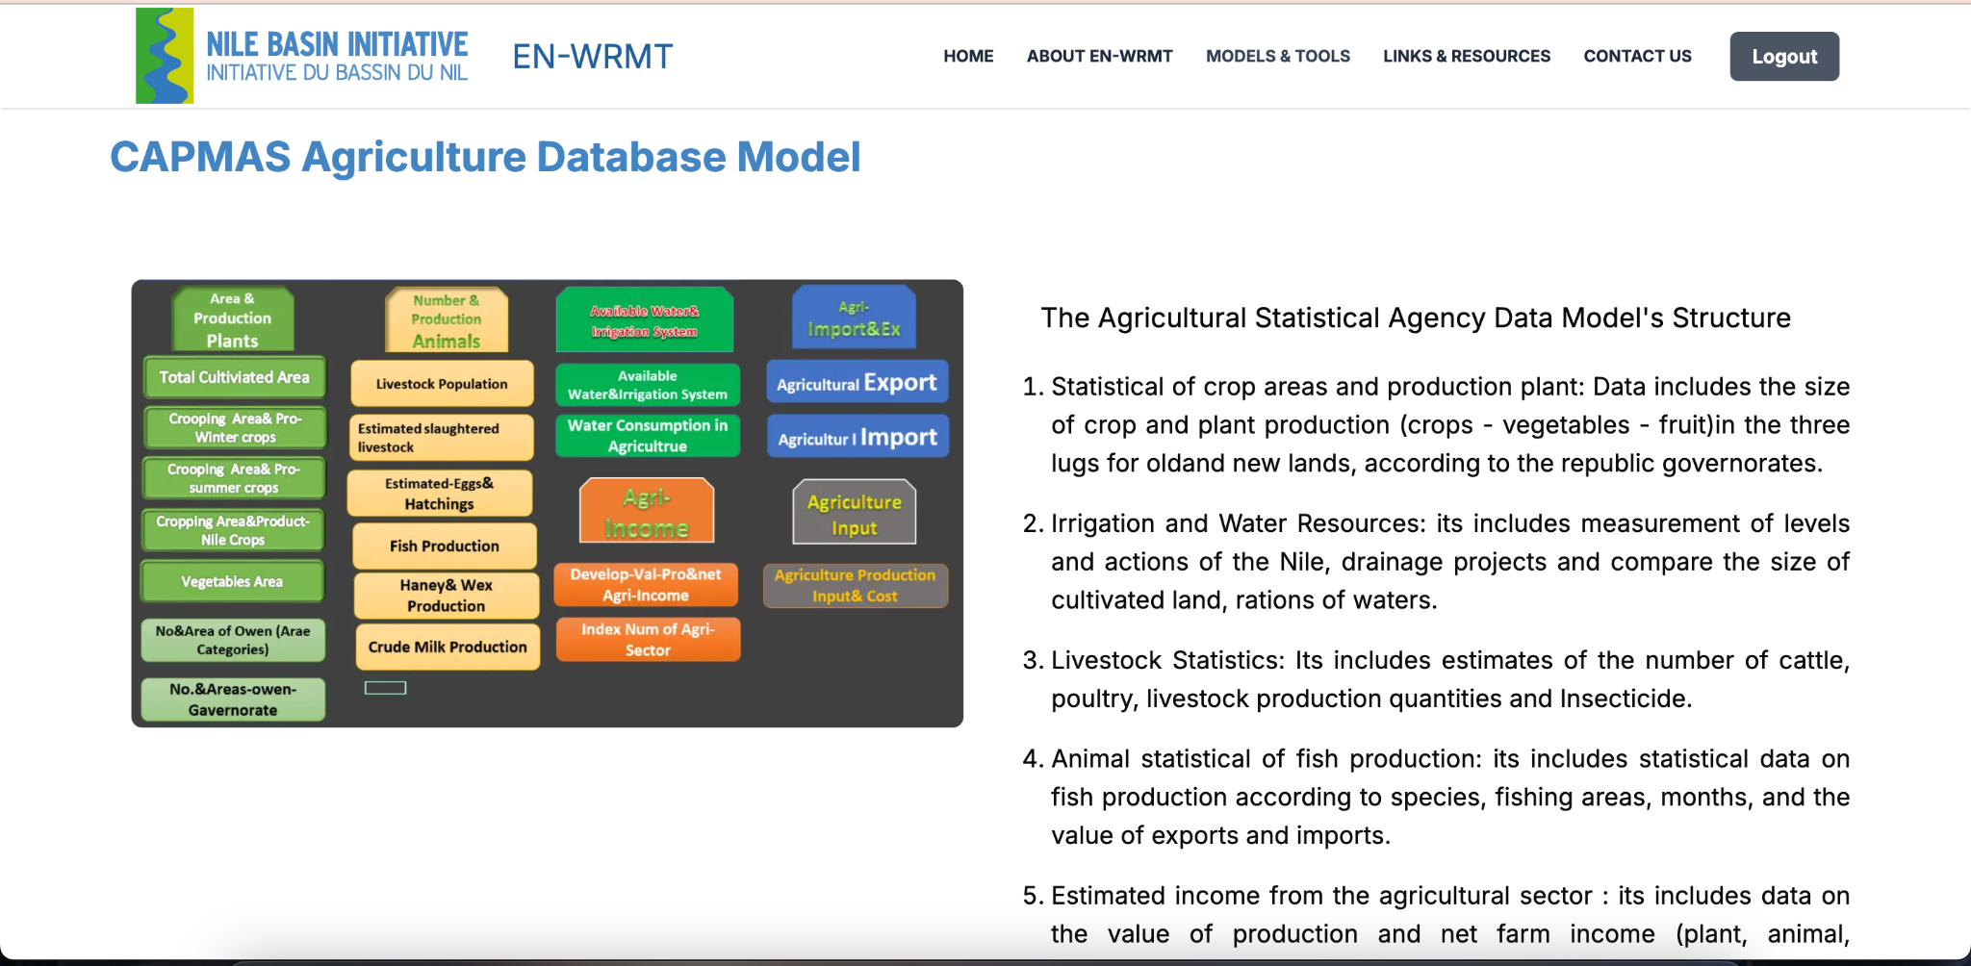
Sub sections: EN-toolkits
CAPMAS Agriculture Database Model
EN-Irrigation and Drainage Toolkit
Watershed Management Toolkit
EN Power Tools and Guidelines Toolkit
Information Management System
CAPMAS Agriculture Database Model
Eastern Nile Irrigation Toolkit

Slide 39
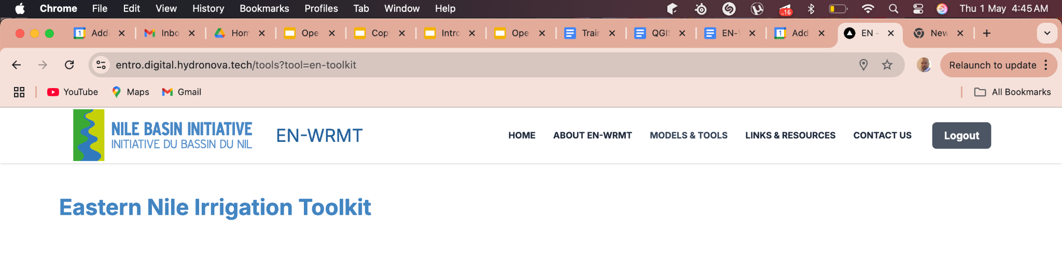
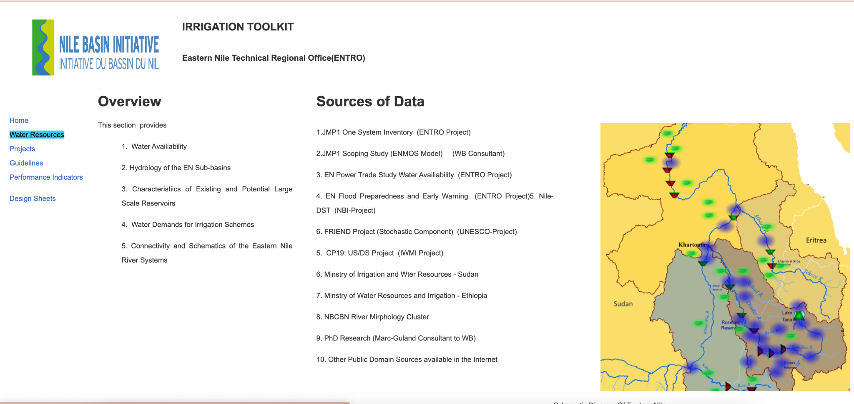
Sub sections: EN-toolkits
Eastern Nile Irrigation Toolkit
EN-Irrigation and Drainage Toolkit
Watershed Management Toolkit
EN Power Tools and Guidelines Toolkit
Information Management System
CAPMAS Agriculture Database Model
Eastern Nile Irrigation Toolkit

Slide 40
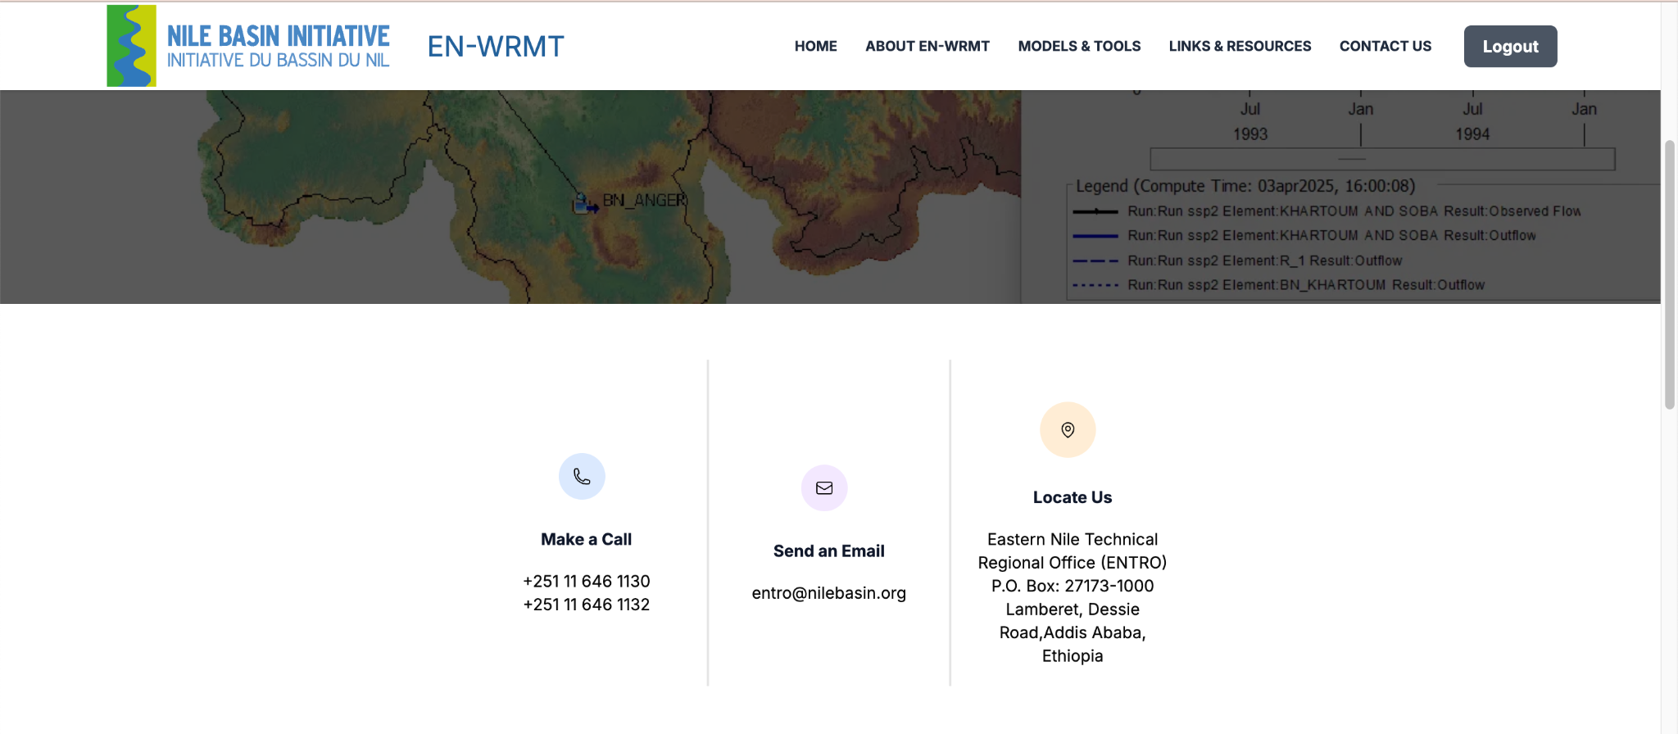
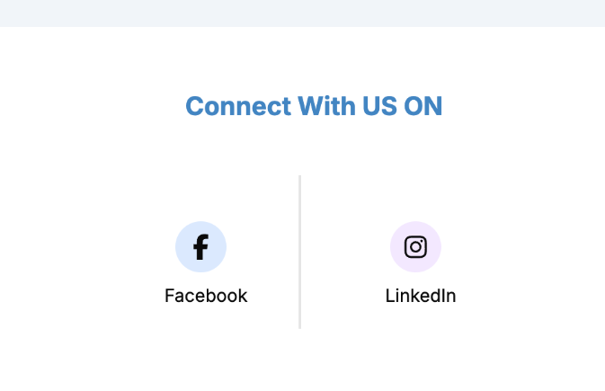
Contact Us section

Slide 41

Authentication and Authorization Protocol
User authentication will be done through login services.
Following successful authentication, authorization will be managed internally by ENTRO administrators.
Administrators will assign roles to new users associated with their email address or another preferred identifier.
The assigned role will determine the user's access to various services on the website.

Slide 42




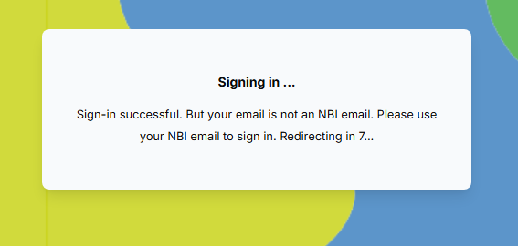

Authentication and Authorization Protocol
User authentication through Clerk
👍
👎

Slide 43
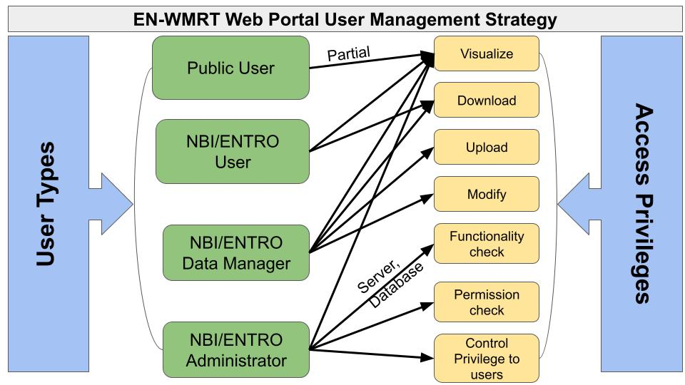
Authentication and Authorization Protocol
1. Public Users: Individuals who access publicly available content on the site without the need to log in.
2. NBI/ENTRO Users: Authorized users who have been granted access to the site, enabling them to view and download materials related to the models and tools.
3. Data Managers: these are ENTRO users with permissions to upload and modify models and toolkits.
5. NBI/ENTRO Admins: Users with full administrative privileges, responsible for creating and managing other user accounts in discussion with the Data managers.

Slide 44
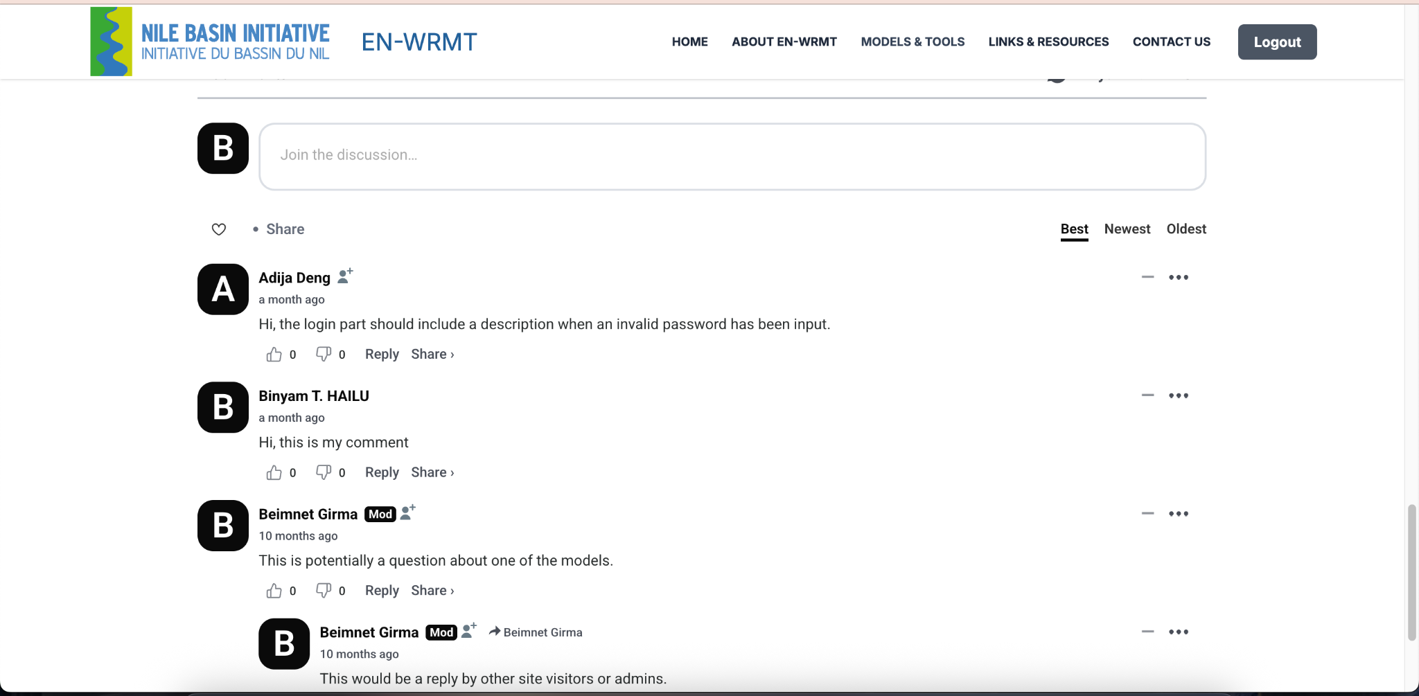
Web-Forum
Web-based forum integrated with the WBGIS Portal to allow users’ discussions around several topics
Such a forum shall be the place where the users can collaborate with each other around the sectors and blog specific to the Models
It was implemented using Open source Software called DISQUS.
DISQUS is a third-party comment management platform that enables user engagement by allowing visitors to post comments, ask questions, and share insights.

Slide 45
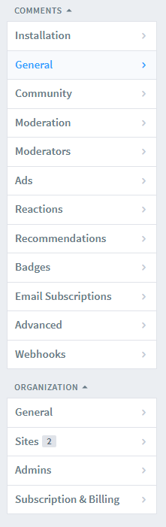
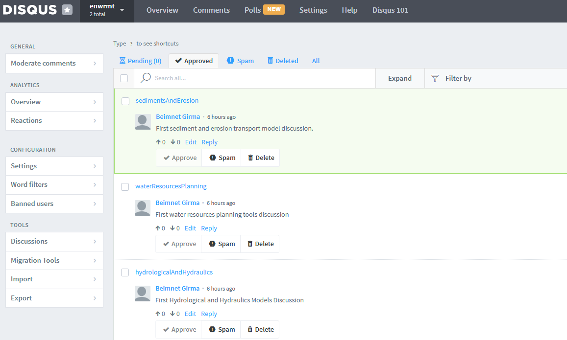
Web-Forum
Disqus Dashboard

Slide 46
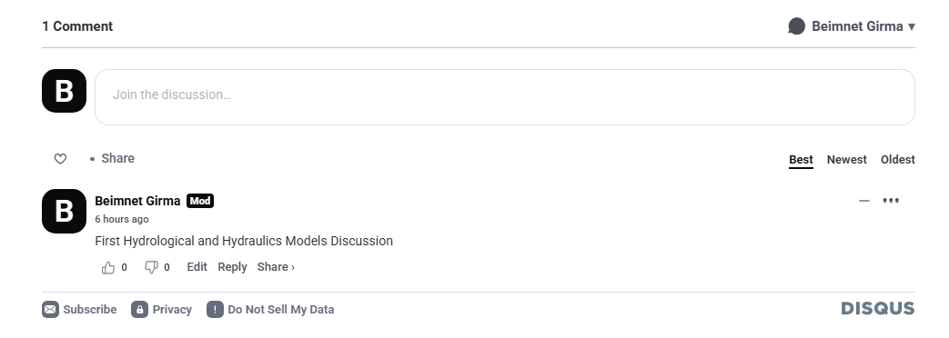
Web-Forum
Disqus Comment

Slide 47
Hardware
The hardware for the platform hosting in a local server at ENTRO and
in the Cloud server, depending on ENTRO adopted approach.
As agreed with ENTRO IT staff, during the development phases, the system has been temporarily hosted on Hydro Nova servers, and now completed,
It was migrated to ENTRO server. NBI/ENTRO IT staff support during this final deployment stage.
The hardware component of the platform include 8GB RAM and 100GB Storage Space
It is needed for:
Database Storage for PostGIS we should have enough space for our spatial database.
Application Files we need space for web application files (HTML, CSS, JavaScript) etc.
Logs and Backups: Plan for log files and regular backups of the databases.
Currently the system is hosted in ENTRO server and can be accessed at the following link:
https://enwrmt.nilebasin.org/ and it will be integrated with the main NBI website https://nilebasin.org/

Slide 48

Links and Resources

Slide 49


From Data to Maps – System Workflow
The system architecture is based on free and open source software (FOSS) for geospatial data management and publishing as well as free tools for the design and development of the Web-GIS application.
Data Storage – Spatial data stored securely in a database (PostGIS).
Data Publishing – GeoServer turns data into web services.
Map Visualization – MapStore displays maps and dashboards to users.
Access – Maps accessible through a web browser: https://enwrmt.nilebasin.org/

Slide 50


Backend Data Management with PostgreSQL-PostGIS
All geographic data is stored in a spatial database.
Ensures consistent, centralized, and efficient access to data.
Data integrity and updates are managed by system administrators.

Slide 51






Making Data Available as Web Services
GeoServer transforms stored data into visual map layers.
Enables real-time map access in browsers and applications.

Slide 52

Interactive Maps and Dashboards for Users
MapStore allows users to:
  Browse maps,
  Zoom, click, and filter layers,
  View charts and dashboards.
No installation needed—access maps online easily

Slide 53

Keeping the System Safe and Updated
Regular backups of data and system files ensure safety.
System updates and monitoring are handled by the admin team.
User data and access remain secure and reliable

Slide 54
Validation Workshop User Login:
User name: entro@testing.com
Password: testing123

